Slide 1
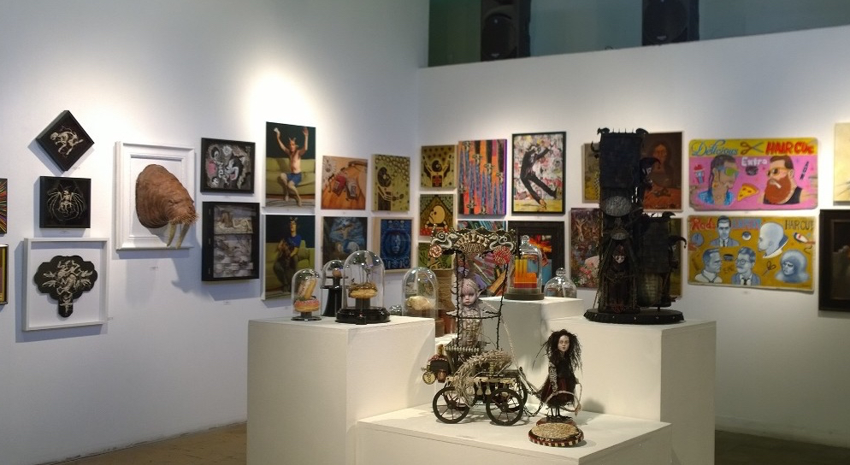






Effect and Correlation of Art Exhibits
Final Report
ALOK ABHISHEK
YI-JIRR CHEN
NI-CHING CHUNG
JONATHAN KAO
SO MIWA

Slide 2
Agenda
Executive Summary
Analysis Process
Data Description
Data Analysis
Conclusion
Dashboard Presentation
Risks and Mitigation

Slide 3
Executive Summary
Many case studies use metrics such as unemployment rate and household income
Unemployment rate reduces with increase in # of art projects
Many metrics show polynomial relationship with # of arts
# of art and income will enable cluster analysis of different areas in LA
# of Art will reflect the commercialization of the area and the creation of jobs related to tourism

Slide 4

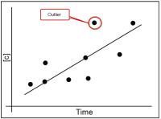
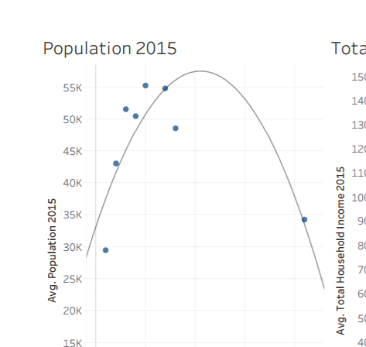


Process Overview
Data Collection
Outlier Analysis
Regression
Cluster Analysis
Correlation Analysis

Slide 5

Data Description
Total Population
Total Household Income
Unemployment # and rate
Per Capita Household Income
# of Employment in Art & Entertainment
Population of highs school graduate or higher
Remarks
Based on studies on economic impact of art
Compared 2010 & 2015 data to analyze the relevance of correlation

Slide 6
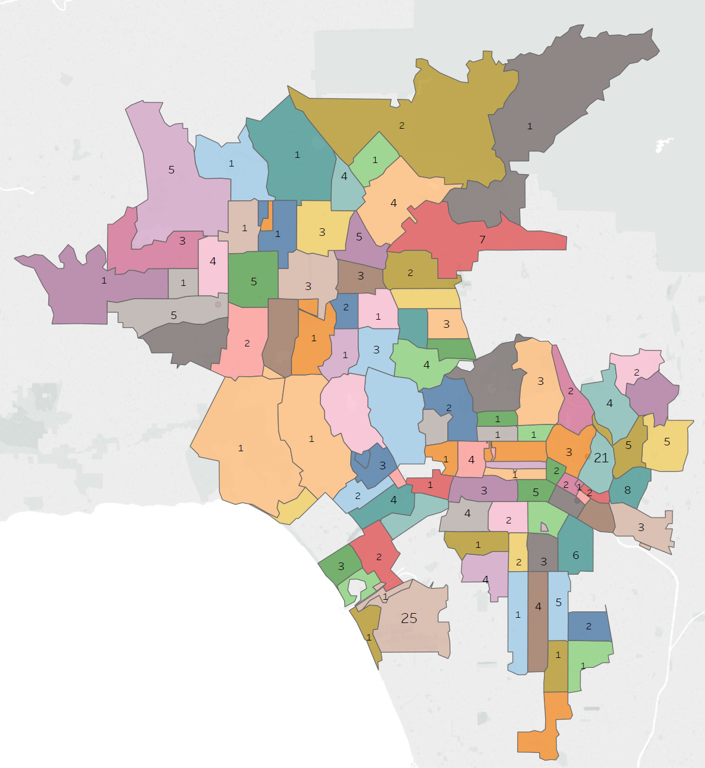
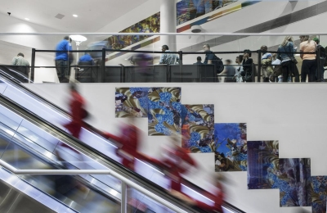
Outlier Treatments-1
Area 90045 has 25 art exhibits in the region
LAX Airport accounts for this high number
As the rest of the area does not have similar facility, we have deducted this outlier for some of the KPIs (Eg. Population)

Slide 7
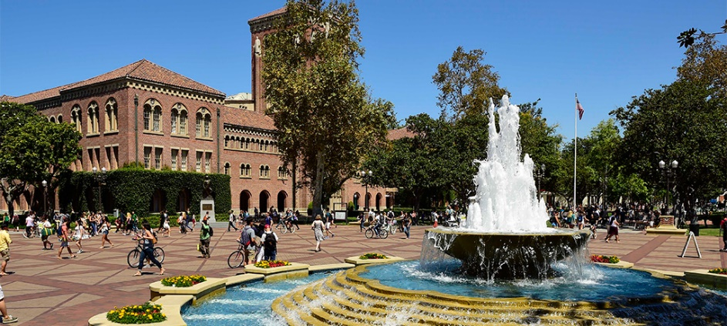
Outlier Treatments-2
Area 90011 has 6 art exhibits in the region
This area has USC in it, with many students (unemployed) and lower income, we will exclude this region for some of the KPIs

Slide 8
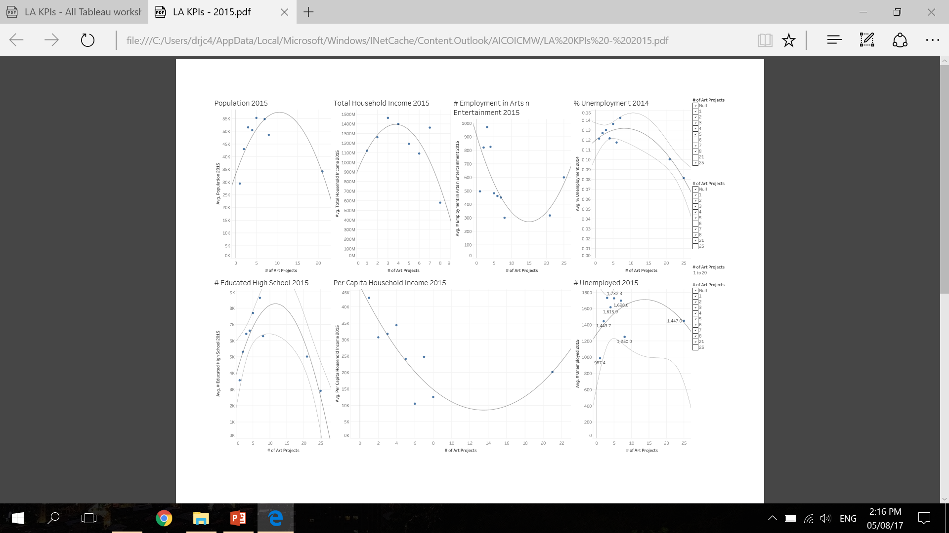
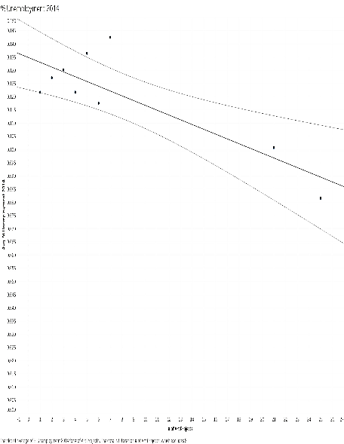
Analysis of 2015

Slide 9
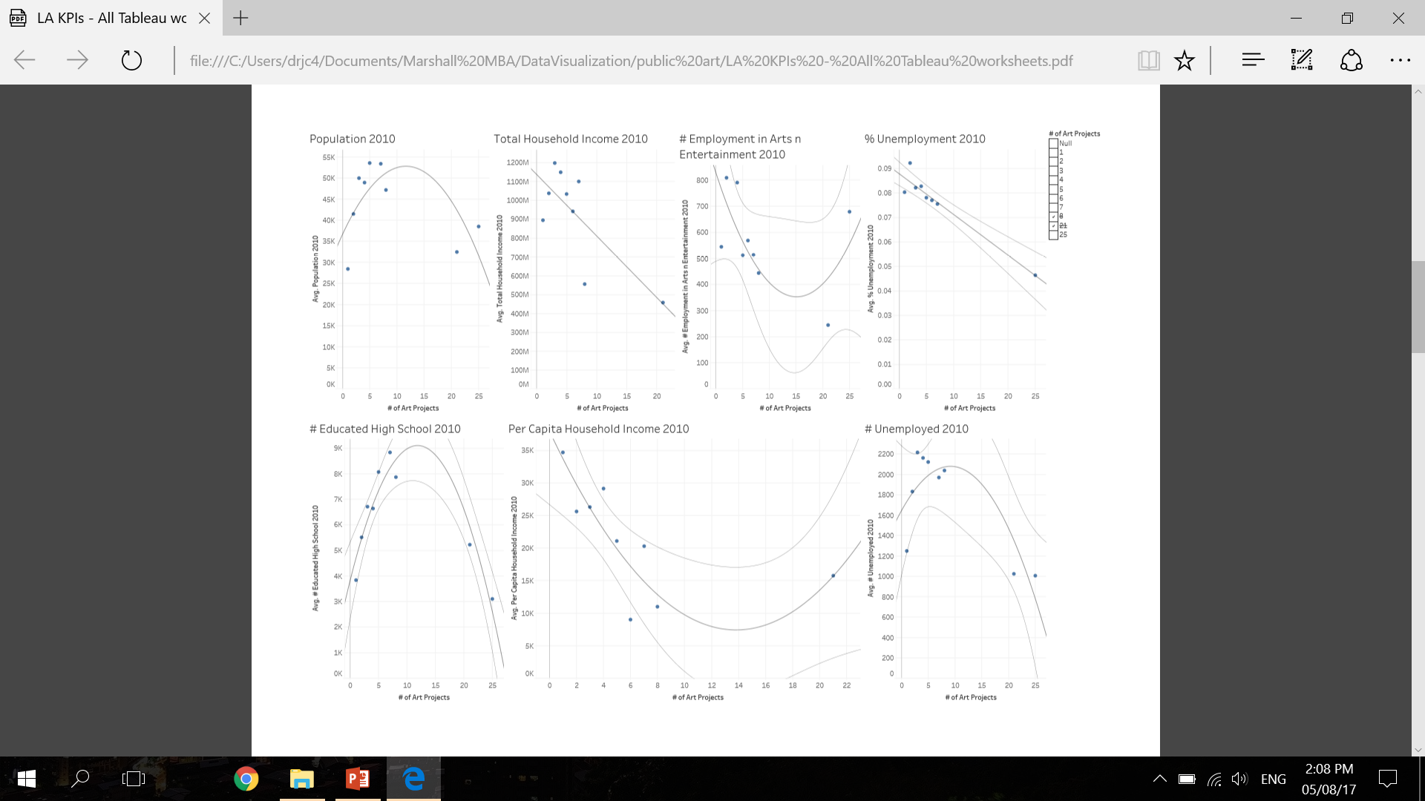
Analysis of 2010
The trend lines are similar to the 2015’s.

Slide 10
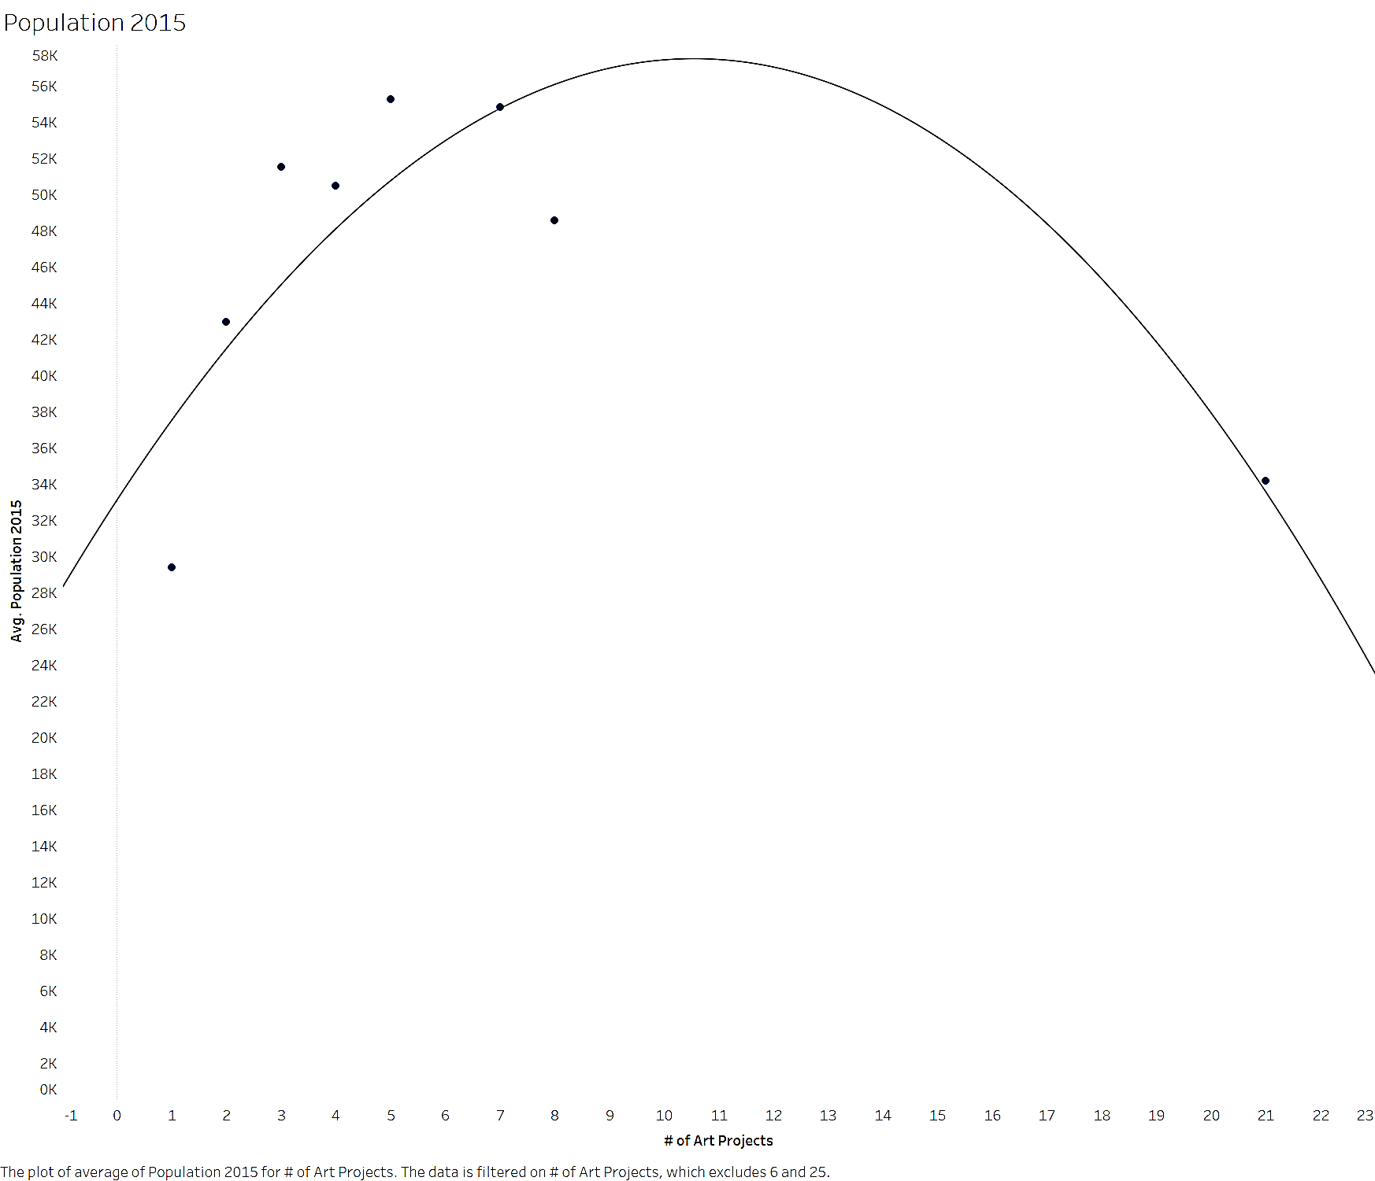
Analysis of 2015 Population
Trend Lines Model
A polynomial trend model of degree 2 is computed for average of Population 2015 given # of Art Projects. The model may be significant at p <= 0.05.
When # of art projects < 10, arts↑ pop↑
When # of art projects >10, arts↑ pop↓
Model formula: | ( # of Art Projects^2 + # of Art Projects + intercept )
Number of modeled observations: | 8
Number of filtered observations: | 1
Model degrees of freedom: | 3
Residual degrees of freedom (DF): | 5
SSE (sum squared error): | 1.9287e+08
MSE (mean squared error): | 3.85741e+07
R-Squared: | 0.70117
Standard error: | 6210.8
p-value (significance): | 0.0488157
Individual trend lines:
Panes |  | Line |  | Coefficients
Row | Column | p-value | DF | Term | Value | StdErr | t-value | p-value
Population 2015 | # of Art Projects | 0.0488157 | 5 | # of Art Projects^2 | -219.138 | 66.7694 | -3.28202 | 0.0219056
 |  |  |  | # of Art Projects | 4624.53 | 1563.2 | 2.95837 | 0.0315782
 |  |  |  | intercept | 33105.4 | 5614.11 | 5.89683 | 0.0019949

Slide 11
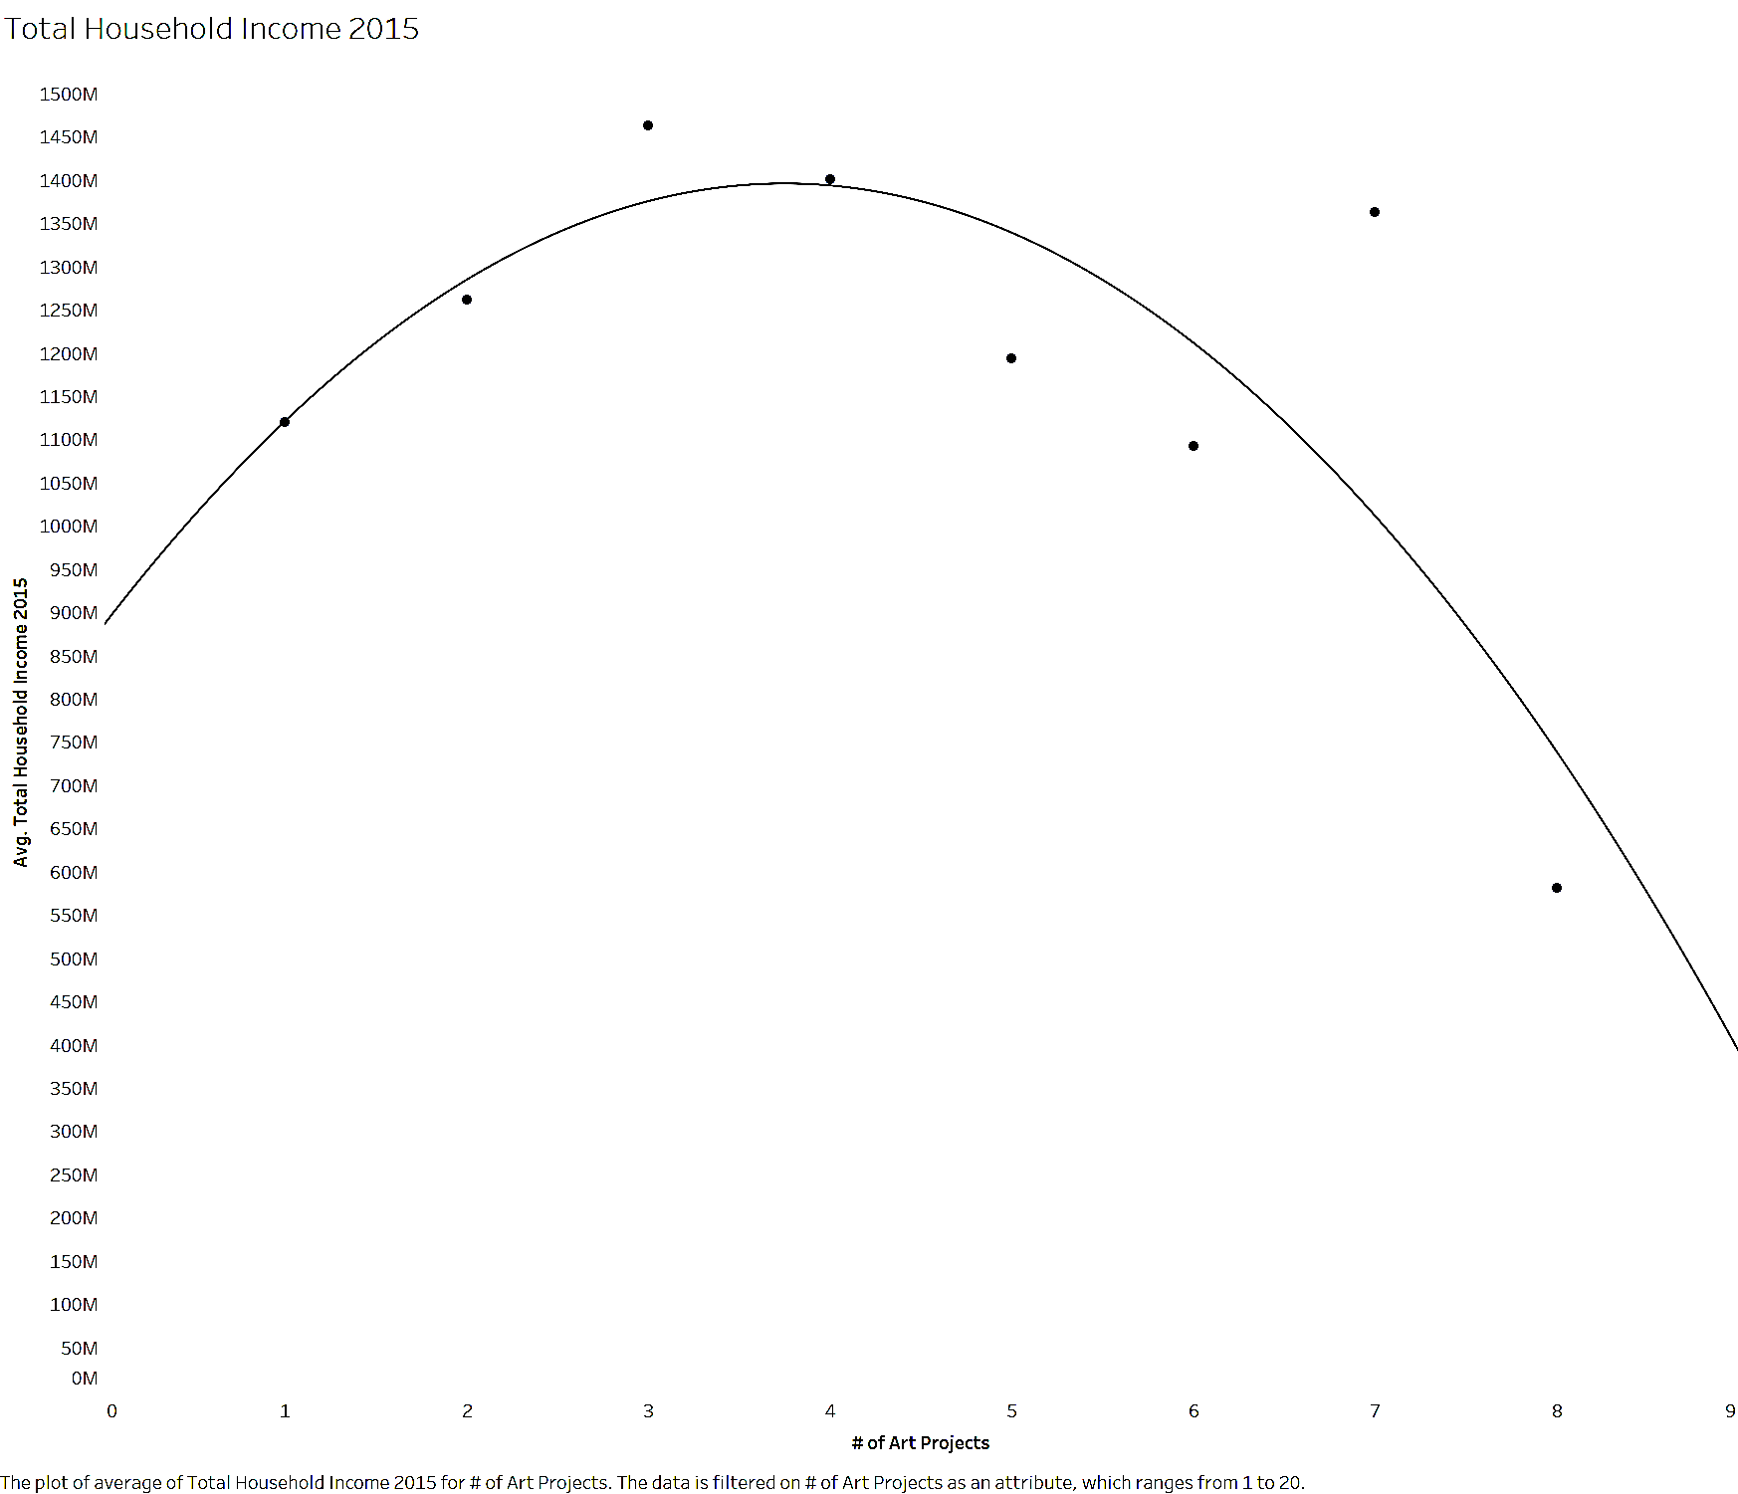
Analysis of 2015 Average of Total Household Income
Trend Lines Model
A polynomial trend model of degree 2 is computed for average of Total Household Income 2015 given # of Art Projects. p <= 0.05
When # of art projects < 4, arts↑ THI↑
When # of art projects >4, arts↑ THI ↓
Model formula: | ( # of Art Projects^2 + # of Art Projects + intercept )
Number of modeled observations: | 8
Number of filtered observations: | 0
Model degrees of freedom: | 3
Residual degrees of freedom (DF): | 5
SSE (sum squared error): | 1.91959e+17
MSE (mean squared error): | 3.83917e+16
R-Squared: | 0.64375
Standard error: | 1.95938e+08
p-value (significance): | 0.075751
Individual trend lines:
Panes |  | Line |  | Coefficients
Row | Column | p-value | DF | Term | Value | StdErr | t-value | p-value
Total Household Income 2015 | # of Art Projects | 0.075751 | 5 | # of Art Projects^2 | -3.63471e+07 | 1.51169e+07 | -2.40439 | 0.0612871
 |  |  |  | # of Art Projects | 2.72585e+08 | 1.39371e+08 | 1.95582 | 0.107863
 |  |  |  | intercept | 8.84884e+08 | 2.73362e+08 | 3.23704 | 0.0230248

Slide 12
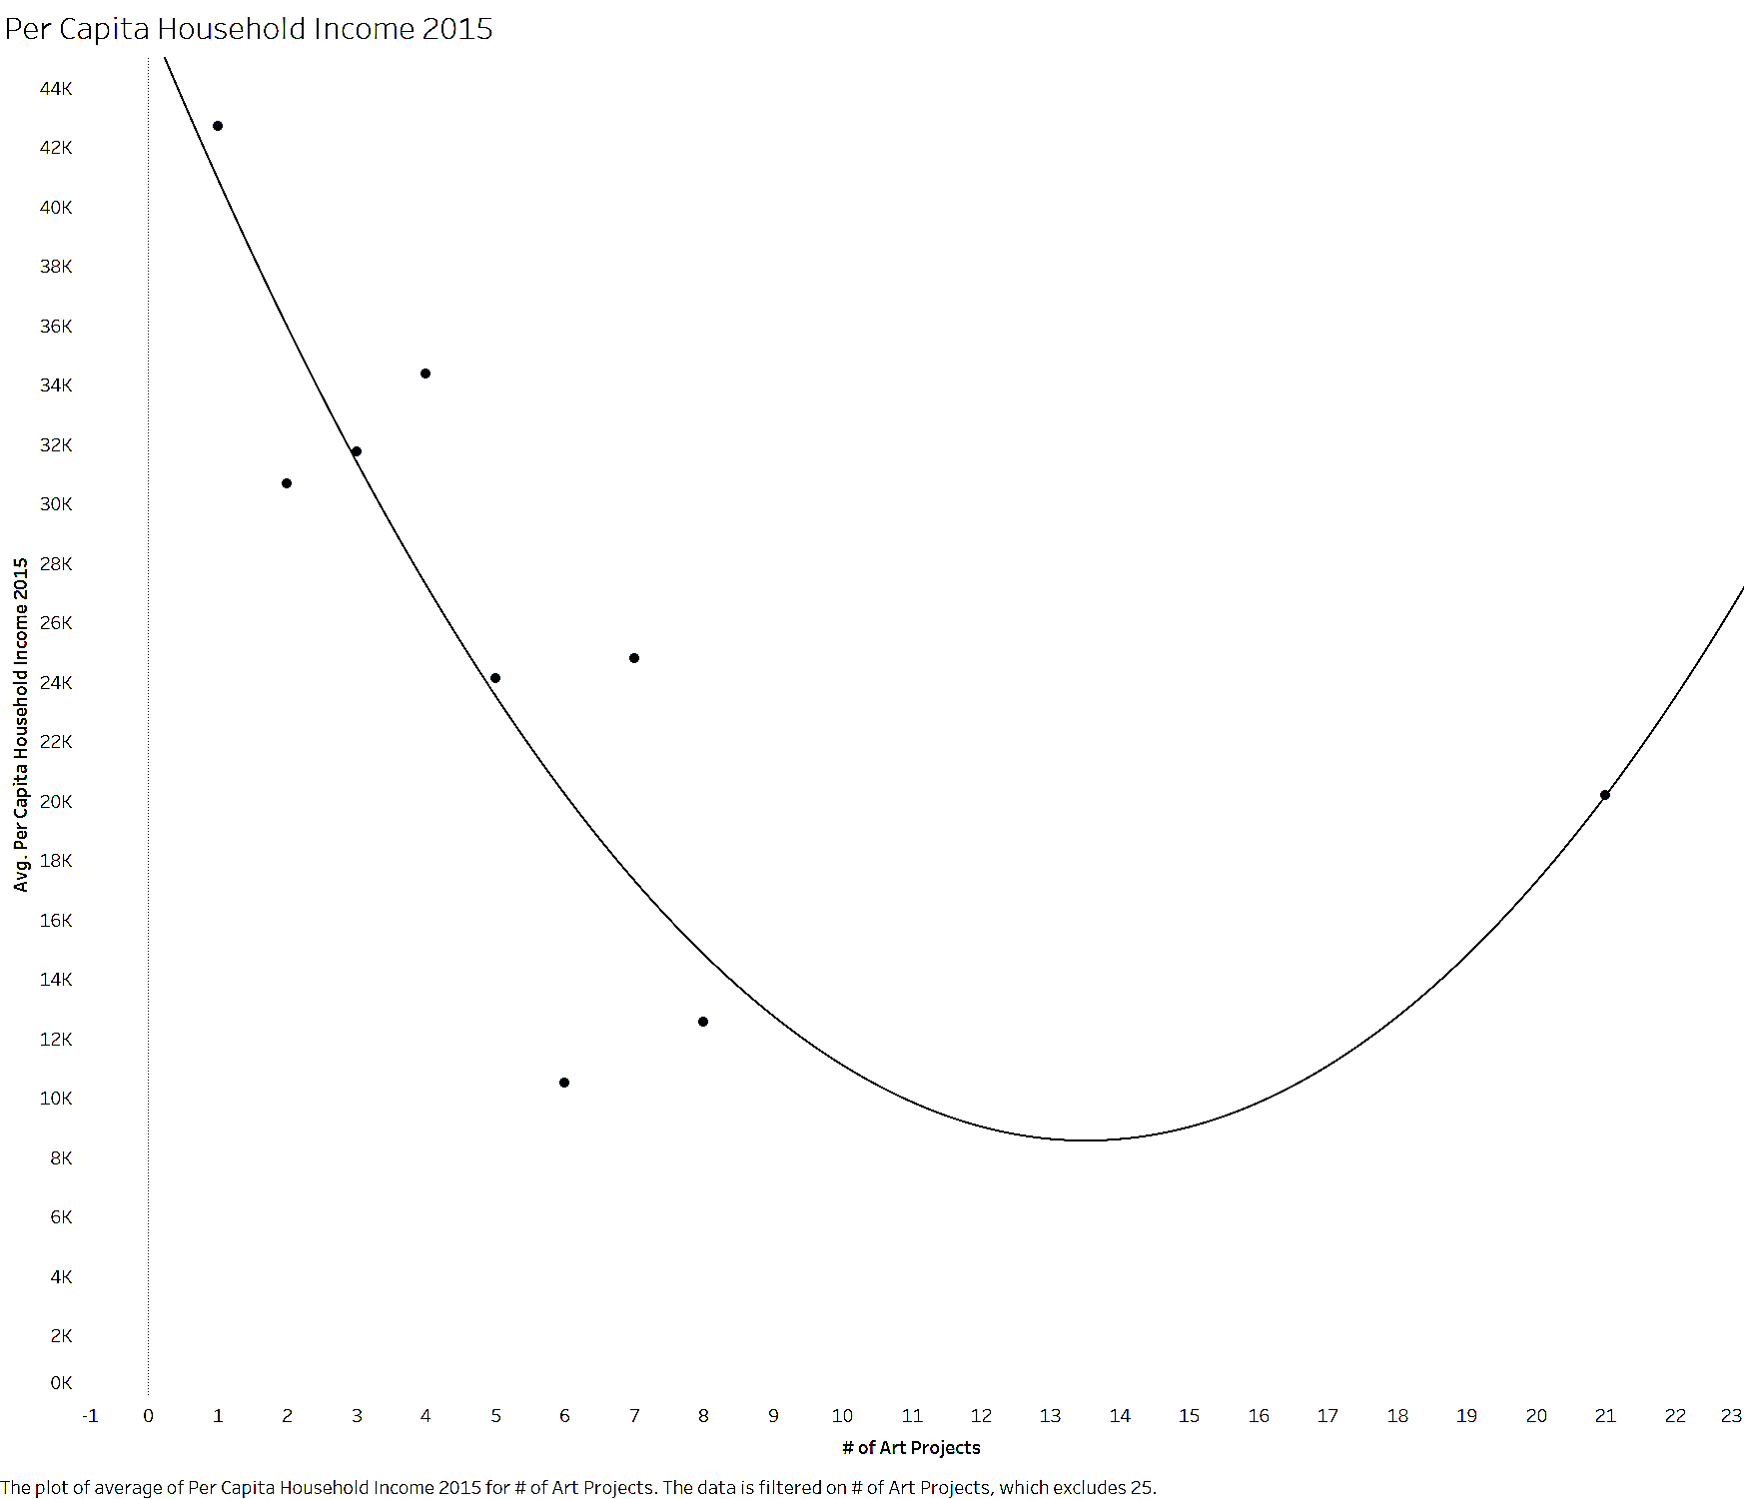
Analysis of 2015 Per Capita Household Income
Trend Lines Model
A polynomial trend model of degree 2 is computed for average of Per Capita Household Income 2015 given # of Art Projects. The model may be significant at p <= 0.05.
When # of art projects < 13, arts↑ PCHI ↓
When # of art projects >13, arts↑ PCHI ↑
Model formula: | ( # of Art Projects^2 + # of Art Projects + intercept )
Number of modeled observations: | 9
Number of filtered observations: | 1
Model degrees of freedom: | 3
Residual degrees of freedom (DF): | 6
SSE (sum squared error): | 2.37187e+08
MSE (mean squared error): | 3.95311e+07
R-Squared: | 0.725078
Standard error: | 6287.38
p-value (significance): | 0.0207792
Individual trend lines:
Panes |  | Line |  | Coefficients
Row | Column | p-value | DF | Term | Value | StdErr | t-value | p-value
Per Capita Household Income 2015 | # of Art Projects | 0.0207792 | 6 | # of Art Projects^2 | 206.714 | 64.3741 | 3.21114 | 0.0183408
 |  |  |  | # of Art Projects | -5586.75 | 1513.7 | -3.69078 | 0.0101992
 |  |  |  | intercept | 46312.9 | 5644.03 | 8.20565 | 0.0001767

Slide 13
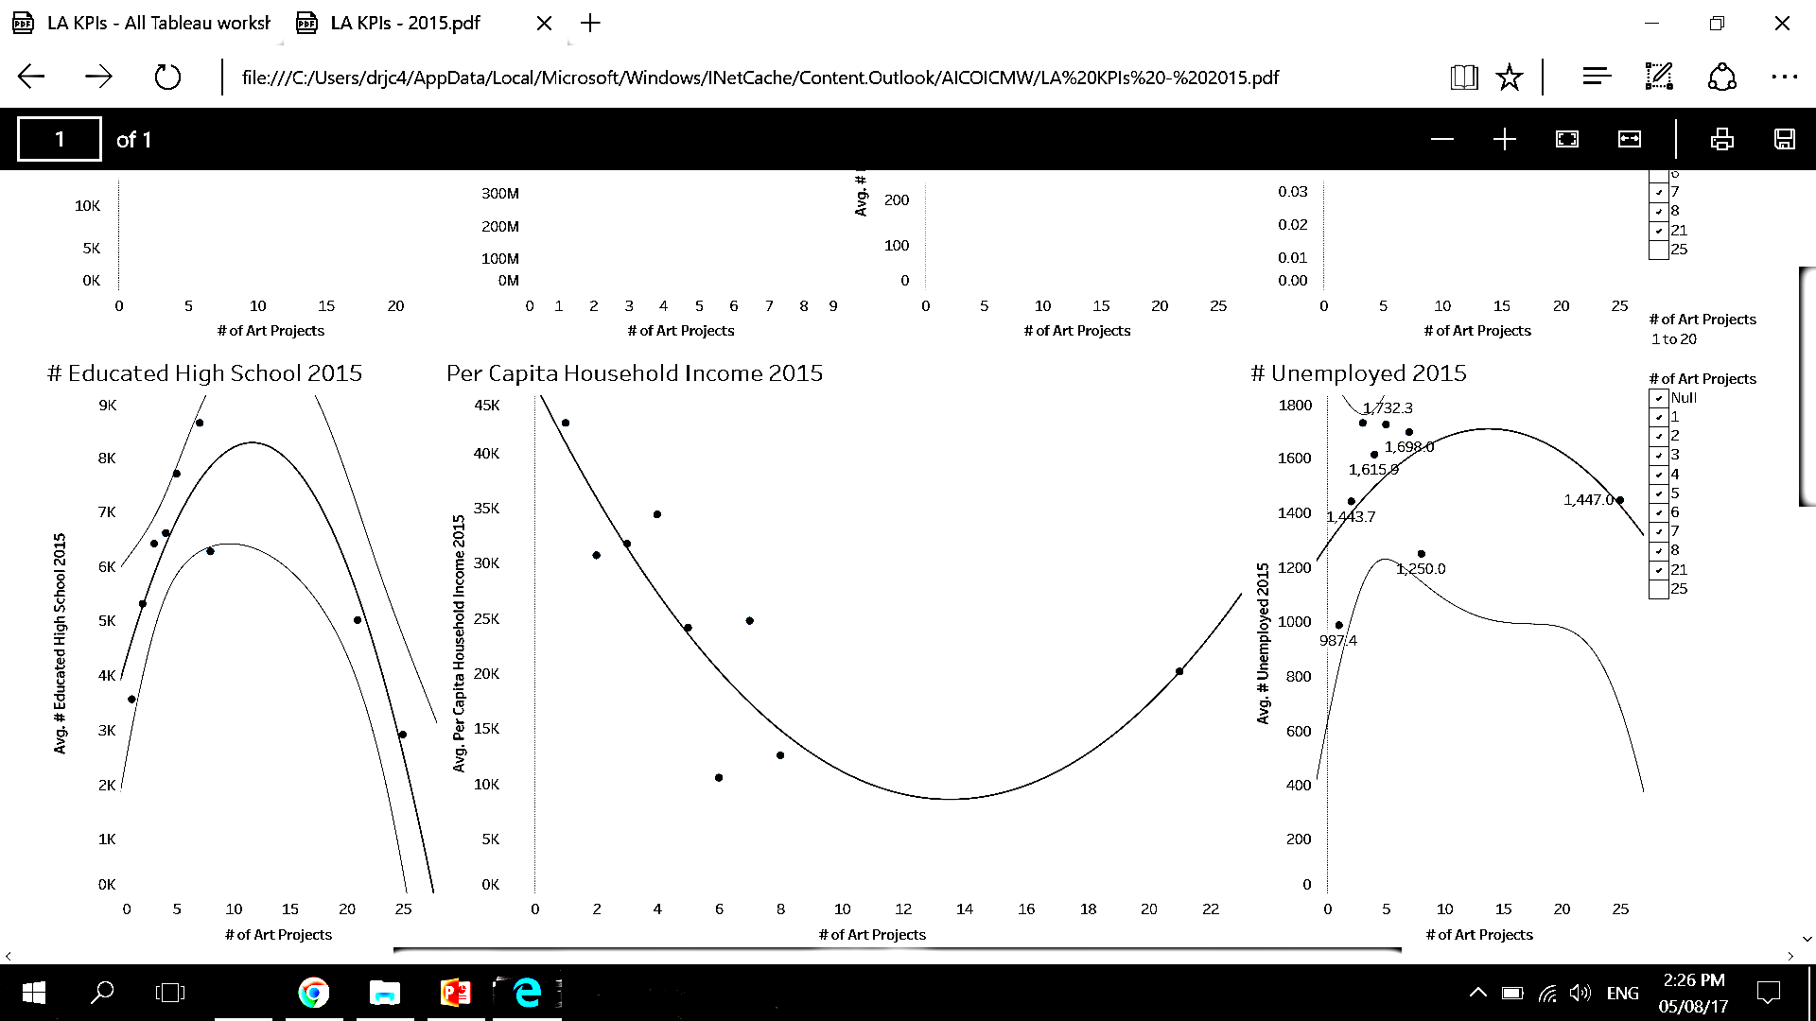
Analysis of 2015 Number Of High School Graduate
Trend Lines Model
A polynomial trend model of degree 2 is computed for average of # Educated High School 2015 given # of Art Projects. The model may be significant at p <= 0.05.
When # of art projects < 11, arts↑ graduate↑
When # of art projects >11, arts↑ graduate ↓
Model formula: | ( # of Art Projects^2 + # of Art Projects + intercept )
Number of modeled observations: | 9
Number of filtered observations: | 1
Model degrees of freedom: | 3
Residual degrees of freedom (DF): | 6
SSE (sum squared error): | 6.10937e+06
MSE (mean squared error): | 1.01823e+06
R-Squared: | 0.774218
Standard error: | 1009.07
p-value (significance): | 0.0115097
Individual trend lines:
Panes |  | Line |  | Coefficients
Row | Column | p-value | DF | Term | Value | StdErr | t-value | p-value
# Educated High School 2015 | # of Art Projects | 0.0115097 | 6 | # of Art Projects^2 | -32.0296 | 8.15166 | -3.92921 | 0.0077197
 |  |  |  | # of Art Projects | 746.794 | 217.958 | 3.42632 | 0.0140343
 |  |  |  | intercept | 3916.81 | 843.081 | 4.64583 | 0.003519

Slide 14
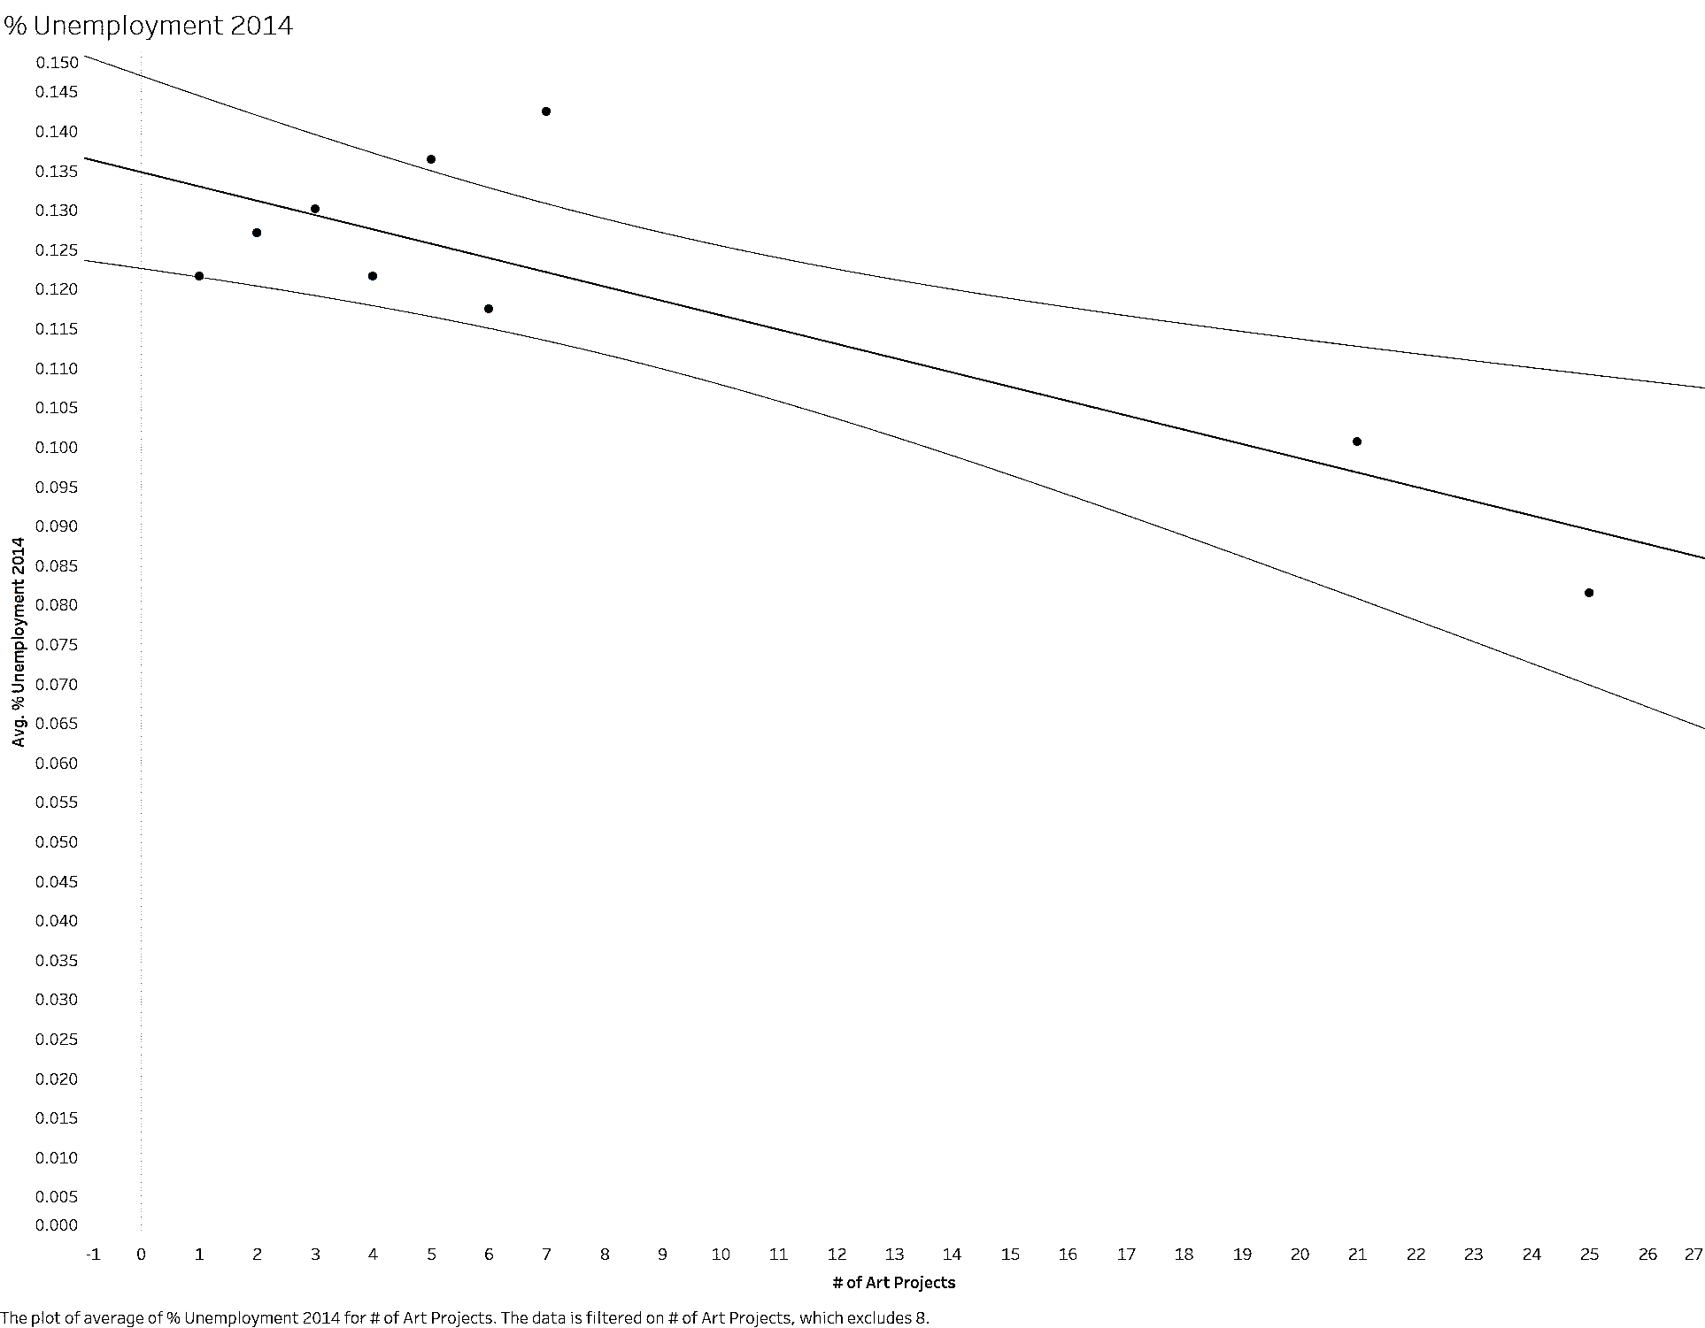
Analysis of 2014 Average of % Unemployment
Trend Lines Model
A linear trend model is computed for average of % Unemployment 2014 given # of Art Projects. The model may be significant at p <= 0.05.
Model formula: | ( # of Art Projects + intercept )
Number of modeled observations: | 9
Number of filtered observations: | 1
Model degrees of freedom: | 2
Residual degrees of freedom (DF): | 7
SSE (sum squared error): | 0.0008319
MSE (mean squared error): | 0.0001188
R-Squared: | 0.702365
Standard error: | 0.0109014
p-value (significance): | 0.0047834
Individual trend lines:
Panes |  | Line |  | Coefficients
Row | Column | p-value | DF | Term | Value | StdErr | t-value | p-value
% Unemployment 2014 | # of Art Projects | 0.0047834 | 7 | # of Art Projects | -0.0018125 | 0.000446 | -4.06432 | 0.0047834
 |  |  |  | intercept | 0.134792 | 0.0051623 | 26.1107 | < 0.0001

Slide 15
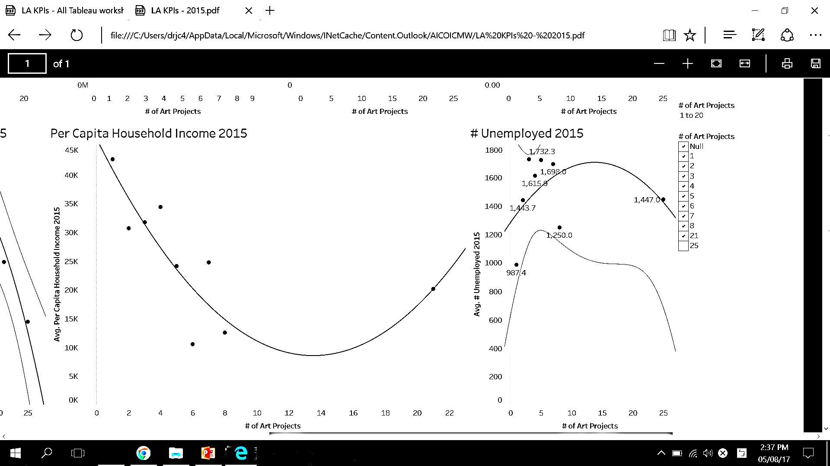
Analysis of 2015 Number Of Unemployed People
Trend Lines Model
A polynomial trend model of degree 2 is computed for average of # Unemployed 2015 given # of Art Projects.
When # of art projects < 14, arts↑ unemployed↑
When # of art projects >14, arts↑ unemployed ↓
Model formula: | ( # of Art Projects^2 + # of Art Projects + intercept )
Number of modeled observations: | 8
Number of filtered observations: | 1
Model degrees of freedom: | 3
Residual degrees of freedom (DF): | 5
SSE (sum squared error): | 415658
MSE (mean squared error): | 83131.7
R-Squared: | 0.146595
Standard error: | 288.326
p-value (significance): | 0.672803
Individual trend lines:
Panes |  | Line |  | Coefficients
Row | Column | p-value | DF | Term | Value | StdErr | t-value | p-value
# Unemployed 2015 | # of Art Projects | 0.672803 | 5 | # of Art Projects^2 | -2.23088 | 2.41417 | -0.924076 | 0.397851
 |  |  |  | # of Art Projects | 61.5084 | 66.9949 | 0.918106 | 0.400684
 |  |  |  | intercept | 1285.65 | 253.644 | 5.06871 | 0.0038713

Slide 16
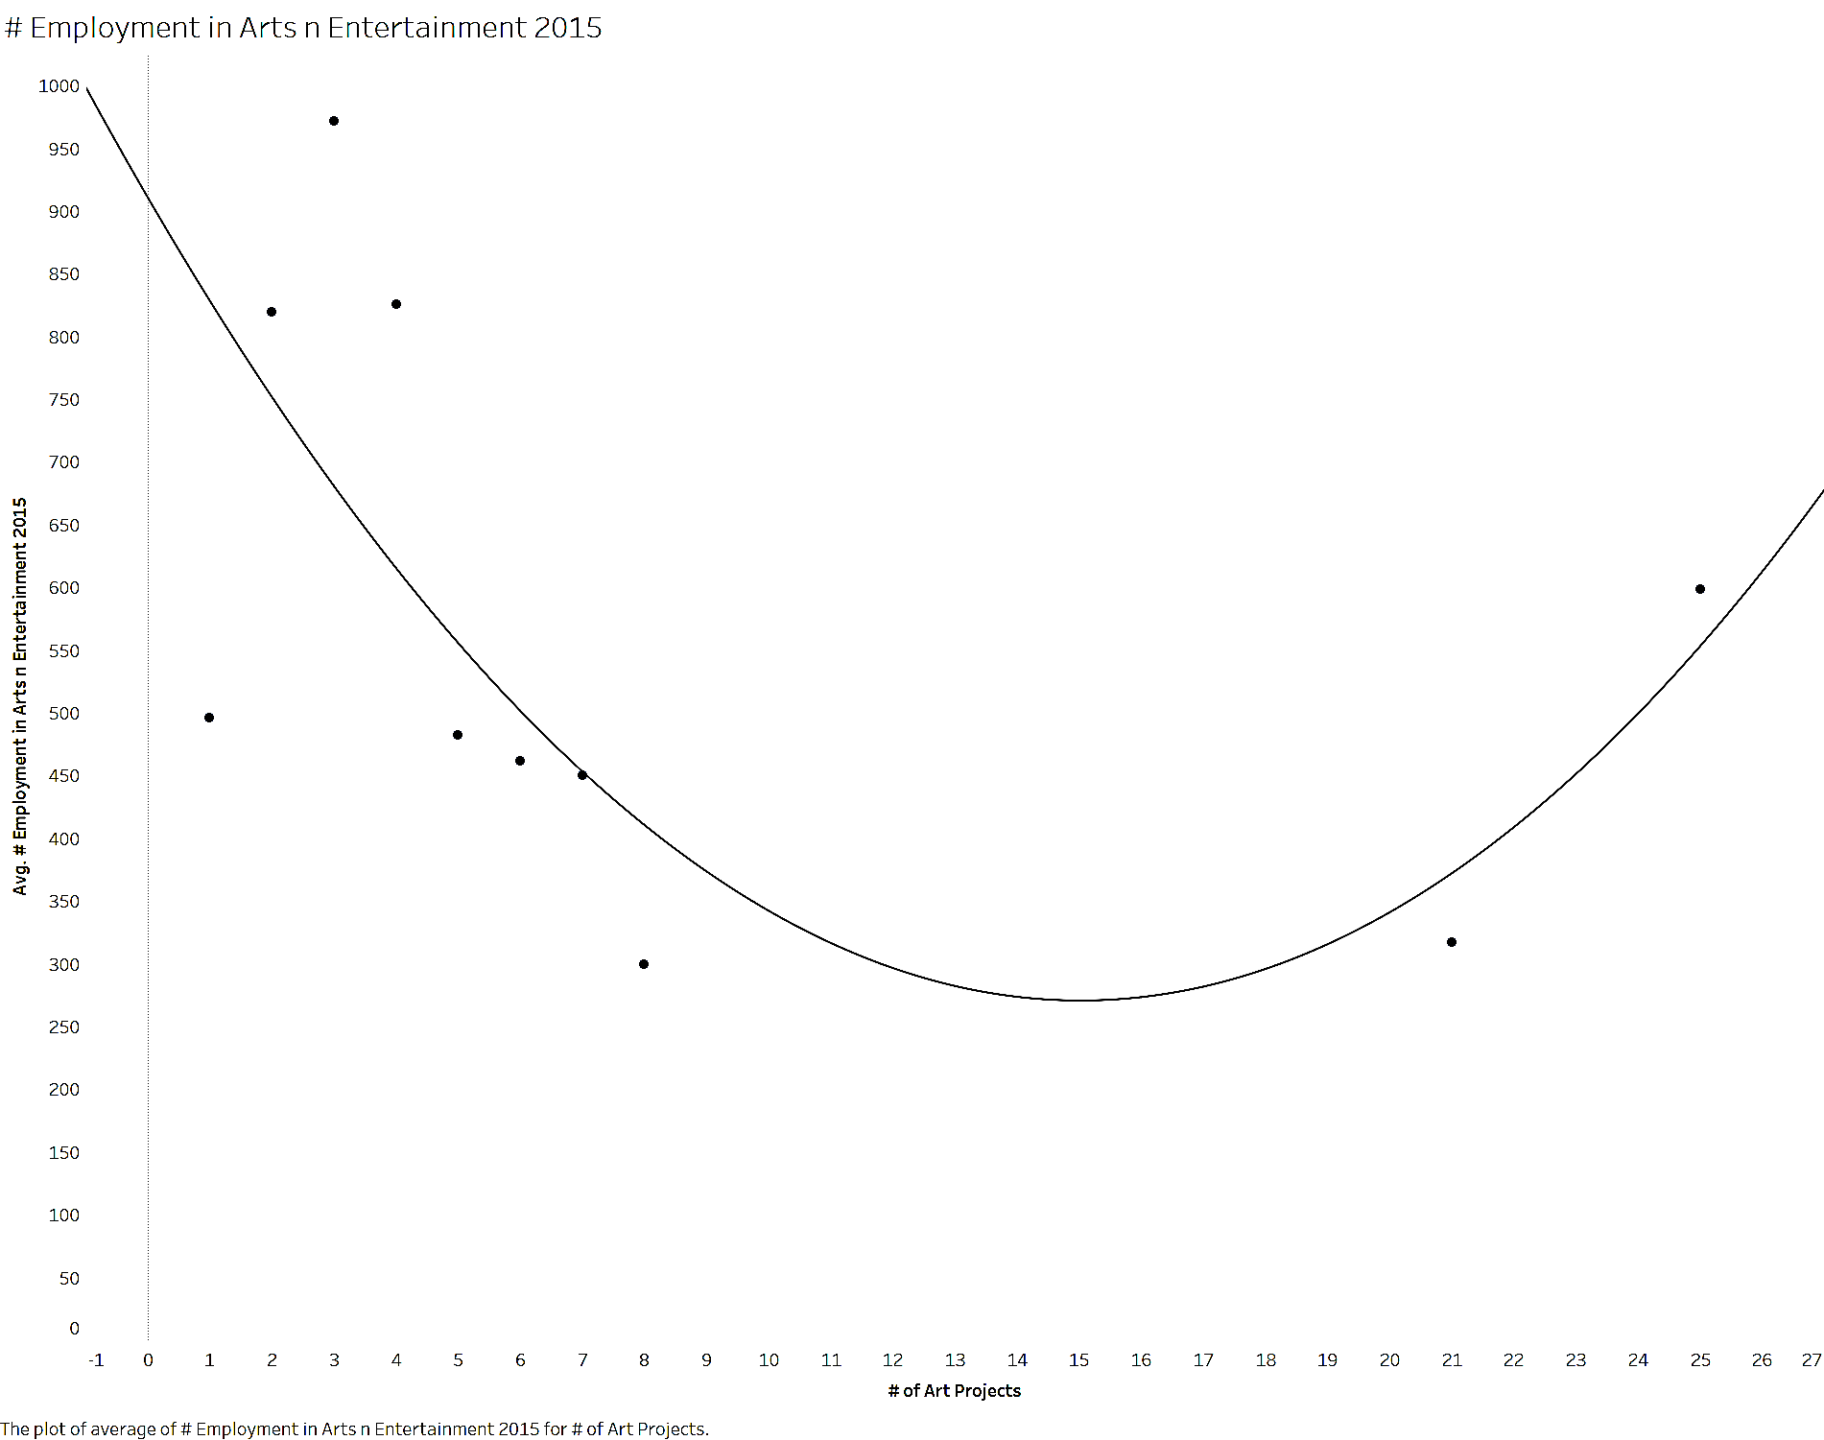
Analysis 2015 Number Of Employment In Arts & Entertainment
Trend Lines Model
A polynomial trend model of degree 2 is computed for average of # Employment in Arts n Entertainment 2015 given # of Art Projects.
When # of art projects < 15, arts↑ EAE ↓
When # of art projects >15, arts↑ EAE ↑
Model formula: | ( # of Art Projects^2 + # of Art Projects + intercept )
Number of modeled observations: | 10
Number of filtered observations: | 1
Model degrees of freedom: | 3
Residual degrees of freedom (DF): | 7
SSE (sum squared error): | 268438
MSE (mean squared error): | 38348.2
R-Squared: | 0.424179
Standard error: | 195.827
p-value (significance): | 0.14488
Individual trend lines:
Panes |  | Line |  | Coefficients
Row | Column | p-value | DF | Term | Value | StdErr | t-value | p-value
# Employment in Arts n Entertainment 2015 | # of Art Projects | 0.14488 | 7 | # of Art Projects^2 | 2.83638 | 1.52263 | 1.86282 | 0.104777
 |  |  |  | # of Art Projects | -85.2424 | 40.9663 | -2.08079 | 0.0759961
 |  |  |  | intercept | 911.193 | 163.289 | 5.58026 | 0.000833

Slide 17
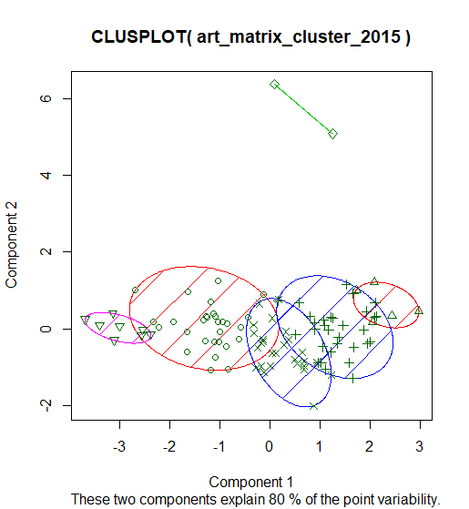
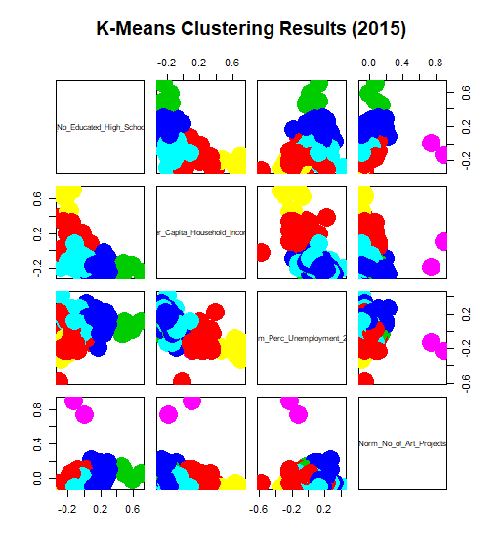
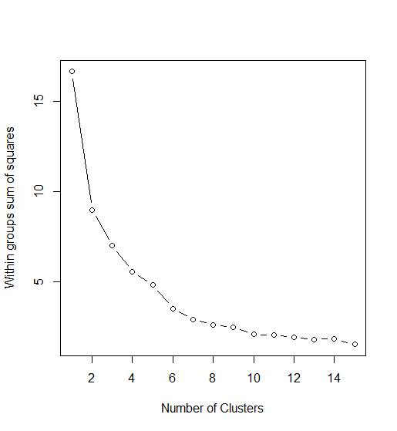
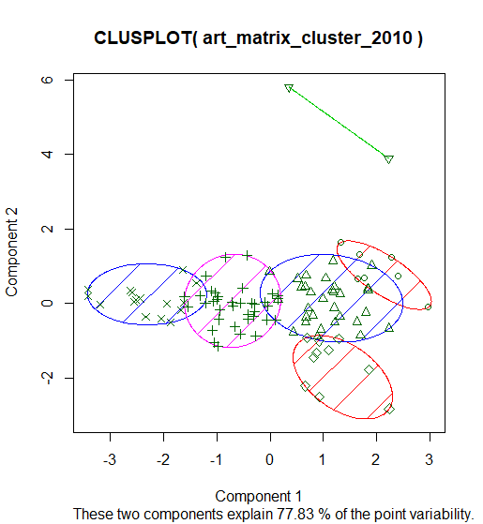
Cluster Analysis-Normalized
Cluster Analysis for selective features (Per Capital Income, Number of Art Project, Education level, Unemployment) revealed that the data can be classified in 6 clusters to minimize the sum of squares.
Looking at the data it seems like high, medium and low per capita income and High number of art Project vs fewer number of Art Project.

Slide 18
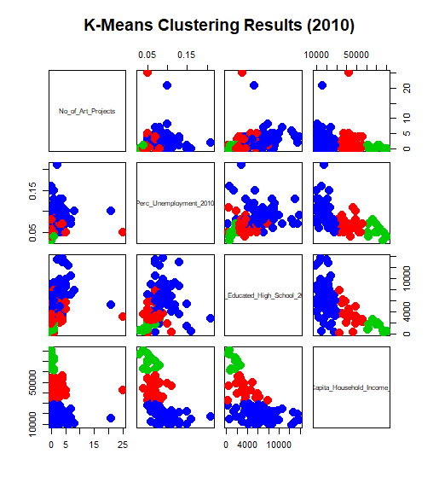
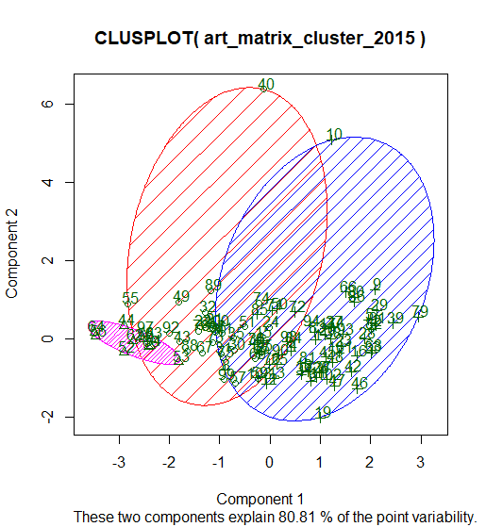
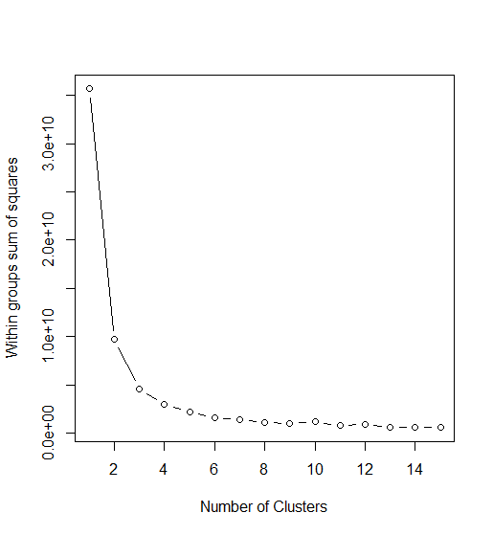
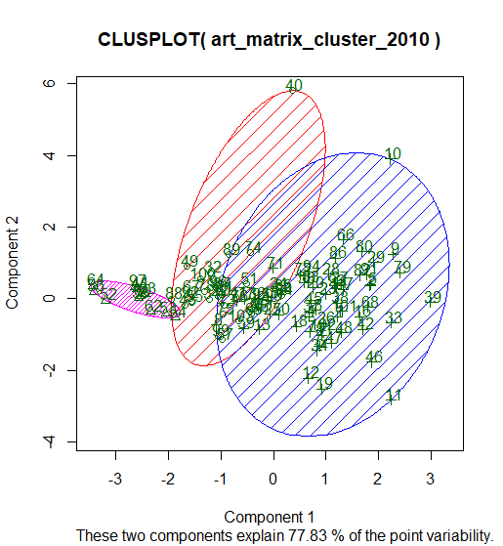
Cluster Analysis-Not-Normalized
Cluster Analysis for selective features (Per Capital Income, Number of Art Project, Education level, Unemployment) revealed that the data can be classified in 3 clusters to minimize the sum of squares.
Looking at the data it seems like high, medium and low per capita income group areas where Art work is installed.

Slide 19
Summary of Analysis
Most metrics reflect polynomial regression -> There is an inflection point for the # of public arts
Most metrics starts out with negative correlation -> # of public art first shows negative correlation with population, income per capita, and education
Income and # of art will enable cluster analysis ->Also, out of the 7 metrics, unemployment rate, per capita household income, and number of high school graduate shows significant correlation

Slide 20





Analysis of 2015
PUBLIC ARTS
Per Capita Household Income
P-value = 0.0207792
# High School Graduate
P-value = 0.0115097
% Unemployment
P-value = 0.0047834
Per Capita Household Income
High School Graduate
% Uemployment
13
# arts
11
# arts
# arts

Slide 21
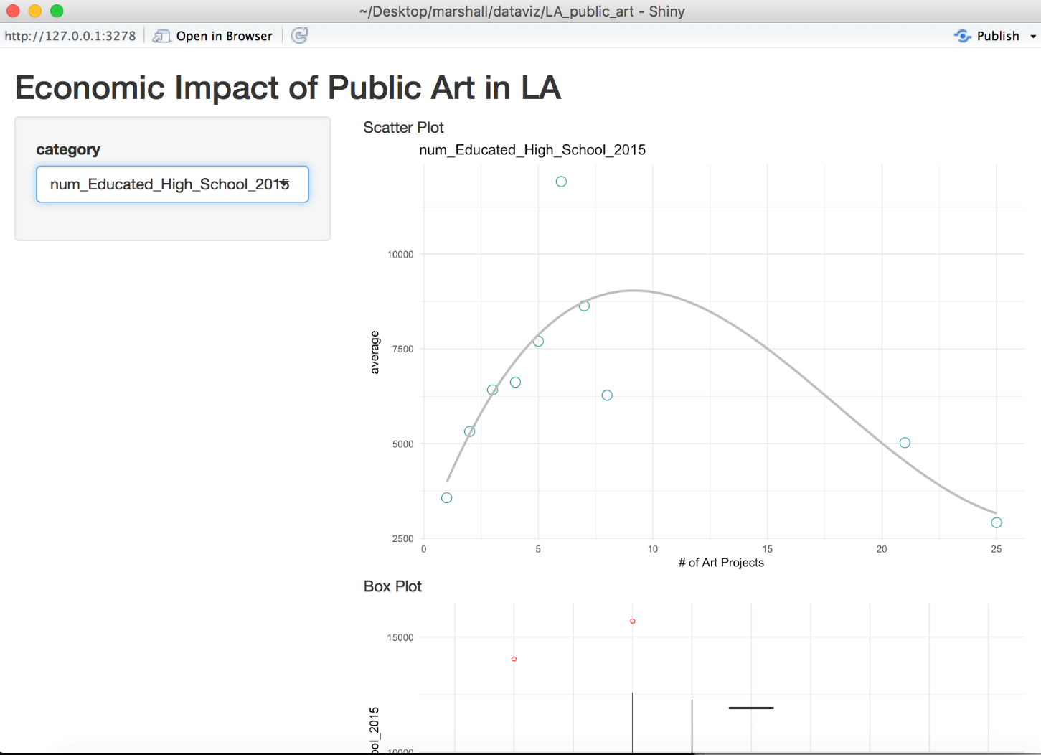
Dashboard Presentation
Refer to the Shiny App posted on GitHub

Slide 22
Hypothesis
Unemployment rate improves with more art exhibit ->Holding art events creates new jobs
After the inflection point, # of high school graduate shows negative correlation ->Commercialization of the area takes over from that inflection point, resulting in creation of tourism job that does not require professional training
Suburban area tend to have fewer art exhibit ->Areas with few art events tends to have more wealthy households

Slide 23

Next Steps: Risks & Mitigations
Data skewed to the left – More data of areas with 8+ art works may change the model
Relevancy of features - Find more case studies to determine variables used to assess the effectiveness of art
Before and After comparison –Data before and after the installation will enable understanding of the correlation
Time length of effectiveness of public arts – Obtaining data over longer time period with more artworks in the period

Slide 24
Appendix

Slide 25
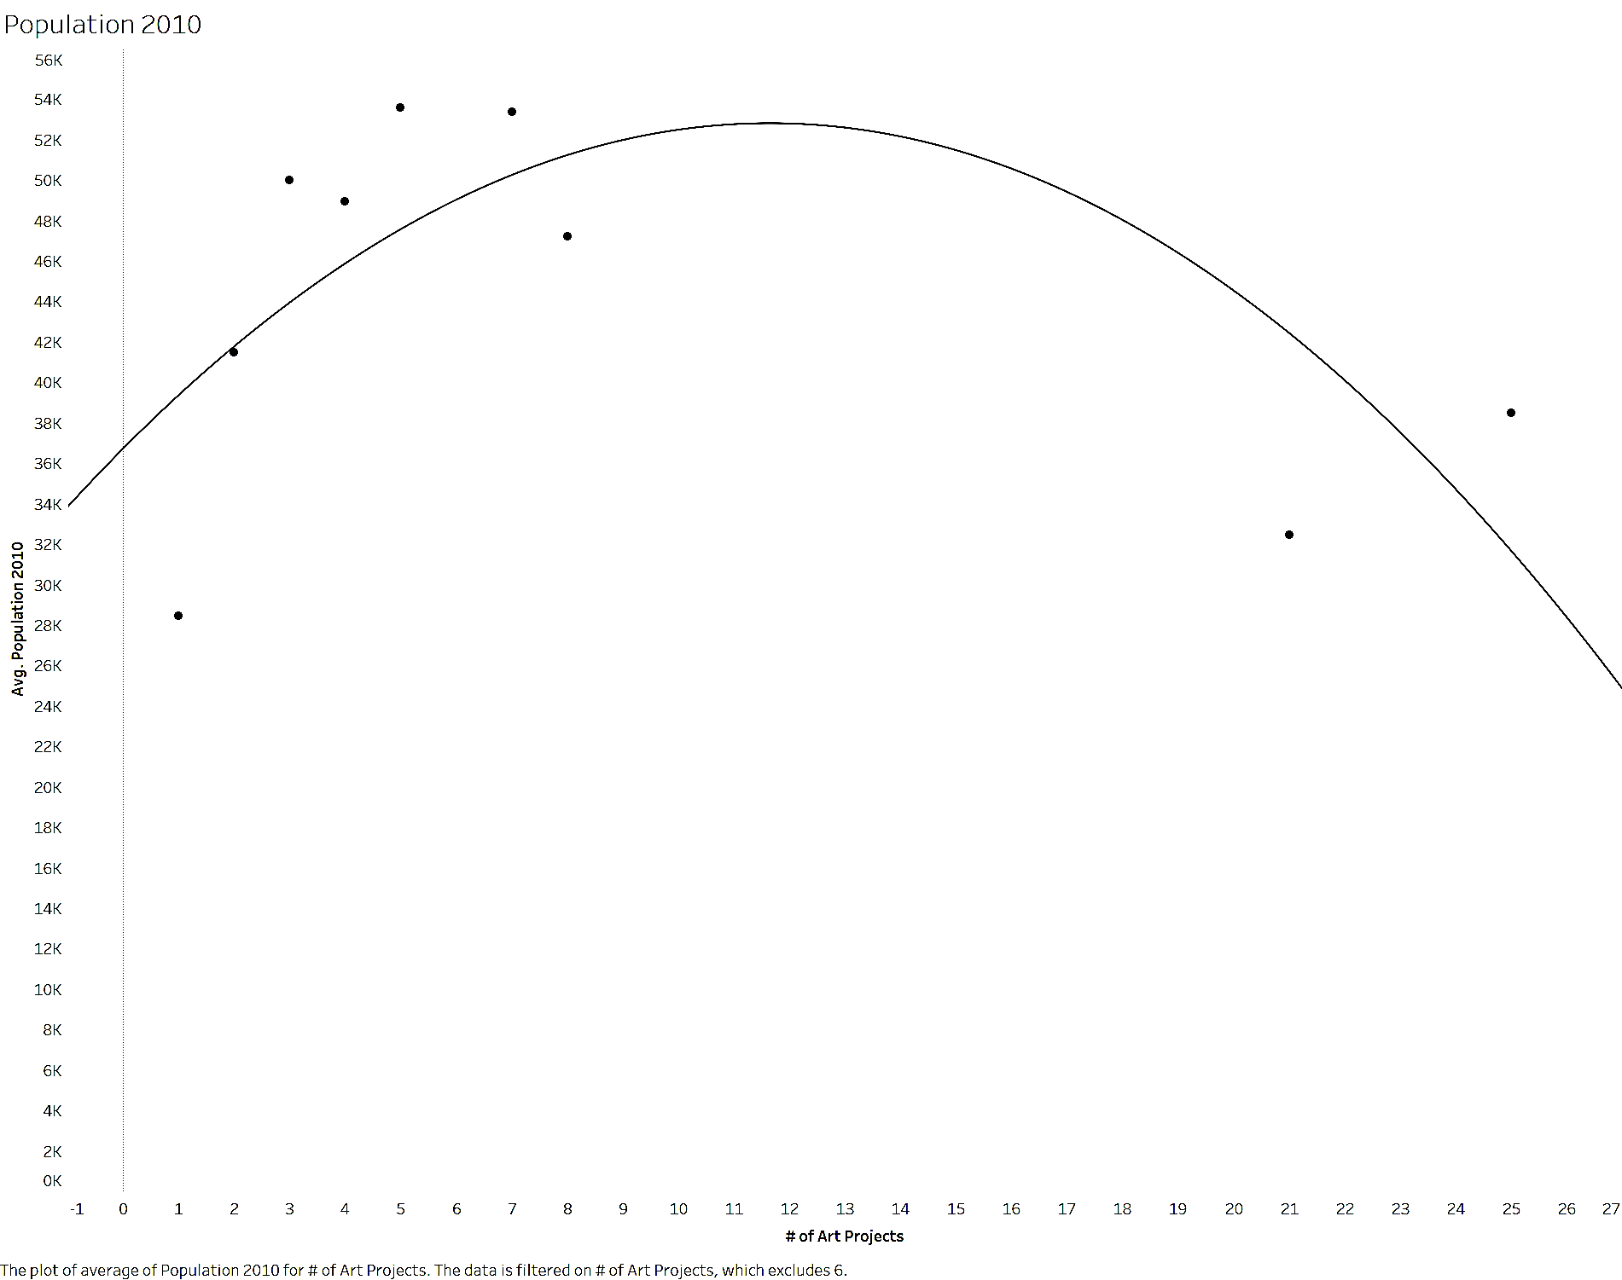
Analysis of 2010 Population
Trend Lines Model
A polynomial trend model of degree 2 is computed for average of Population 2010 given # of Art Projects.
Model formula: | ( # of Art Projects^2 + # of Art Projects + intercept )
Number of modeled observations: | 9
Number of filtered observations: | 1
Model degrees of freedom: | 3
Residual degrees of freedom (DF): | 6
SSE (sum squared error): | 3.73593e+08
MSE (mean squared error): | 6.22656e+07
R-Squared: | 0.435089
Standard error: | 7890.85
p-value (significance): | 0.180277
Panes |  | Line |  | Coefficients
Row | Column | p-value | DF | Term | Value | StdErr | t-value | p-value
Population 2010 | # of Art Projects | 0.180277 | 6 | # of Art Projects^2 | -118.583 | 63.7452 | -1.86027 | 0.112182
 |  |  |  | # of Art Projects | 2763.44 | 1704.41 | 1.62135 | 0.15607
 |  |  |  | intercept | 36714.5 | 6592.81 | 5.56887 | 0.0014211

Slide 26
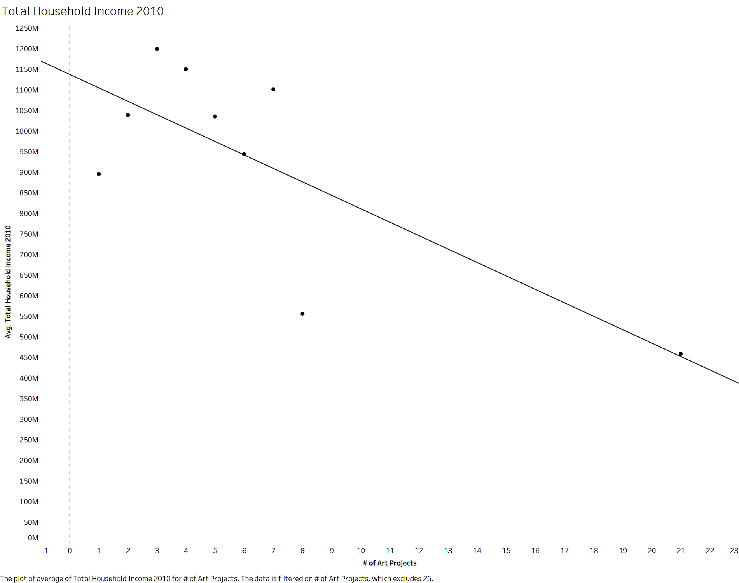
Analysis of 2010 Total Household Income
Trend Lines Model
A linear trend model is computed for average of Total Household Income 2010 given # of Art Projects. The model may be significant at p <= 0.05.
Model formula: | ( # of Art Projects + intercept )
Number of modeled observations: | 9
Number of filtered observations: | 1
Model degrees of freedom: | 2
Residual degrees of freedom (DF): | 7
SSE (sum squared error): | 2.34637e+17
MSE (mean squared error): | 3.35196e+16
R-Squared: | 0.563098
Standard error: | 1.83084e+08
p-value (significance): | 0.0198395
Panes |  | Line |  | Coefficients
Row | Column | p-value | DF | Term | Value | StdErr | t-value | p-value
Total Household Income 2010 | # of Art Projects | 0.0198395 | 7 | # of Art Projects | -3.26317e+07 | 1.0864e+07 | -3.00365 | 0.0198395
 |  |  |  | intercept | 1.13729e+09 | 9.19706e+07 | 12.3658 | < 0.0001

Slide 27
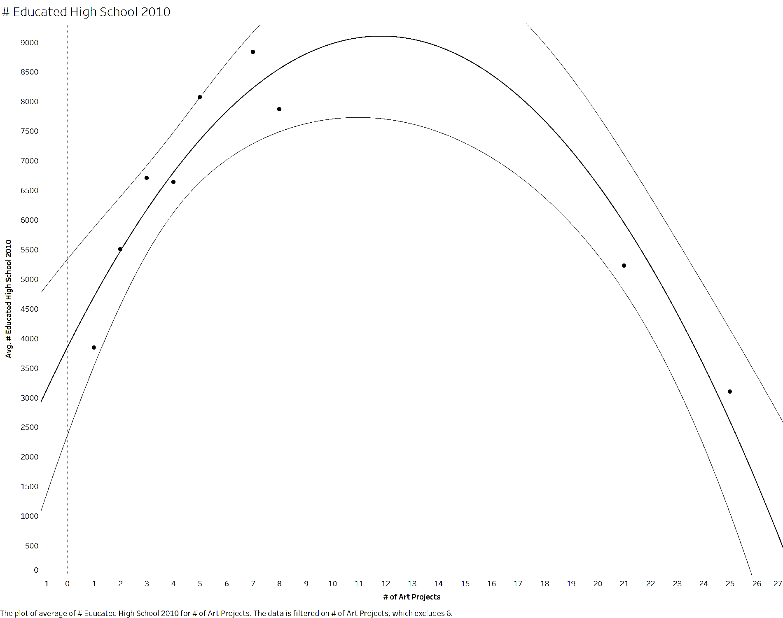
Analysis of 2010 Number of Educated High School Graduated
Trend Lines Model
A polynomial trend model of degree 2 is computed for average of # Educated High School 2010 given # of Art Projects. The model may be significant at p <= 0.05.
Model formula: | ( # of Art Projects^2 + # of Art Projects + intercept )
Number of modeled observations: | 9
Number of filtered observations: | 1
Model degrees of freedom: | 3
Residual degrees of freedom (DF): | 6
SSE (sum squared error): | 3.17283e+06
MSE (mean squared error): | 528805
R-Squared: | 0.895345
Standard error: | 727.19
p-value (significance): | 0.0011463
Panes |  | Line |  | Coefficients
Row | Column | p-value | DF | Term | Value | StdErr | t-value | p-value
# Educated High School 2010 | # of Art Projects | 0.0011463 | 6 | # of Art Projects^2 | -37.5408 | 5.8745 | -6.39047 | 0.0006911
 |  |  |  | # of Art Projects | 888.634 | 157.072 | 5.65751 | 0.0013099
 |  |  |  | intercept | 3844.96 | 607.568 | 6.32844 | 0.0007279

Slide 28
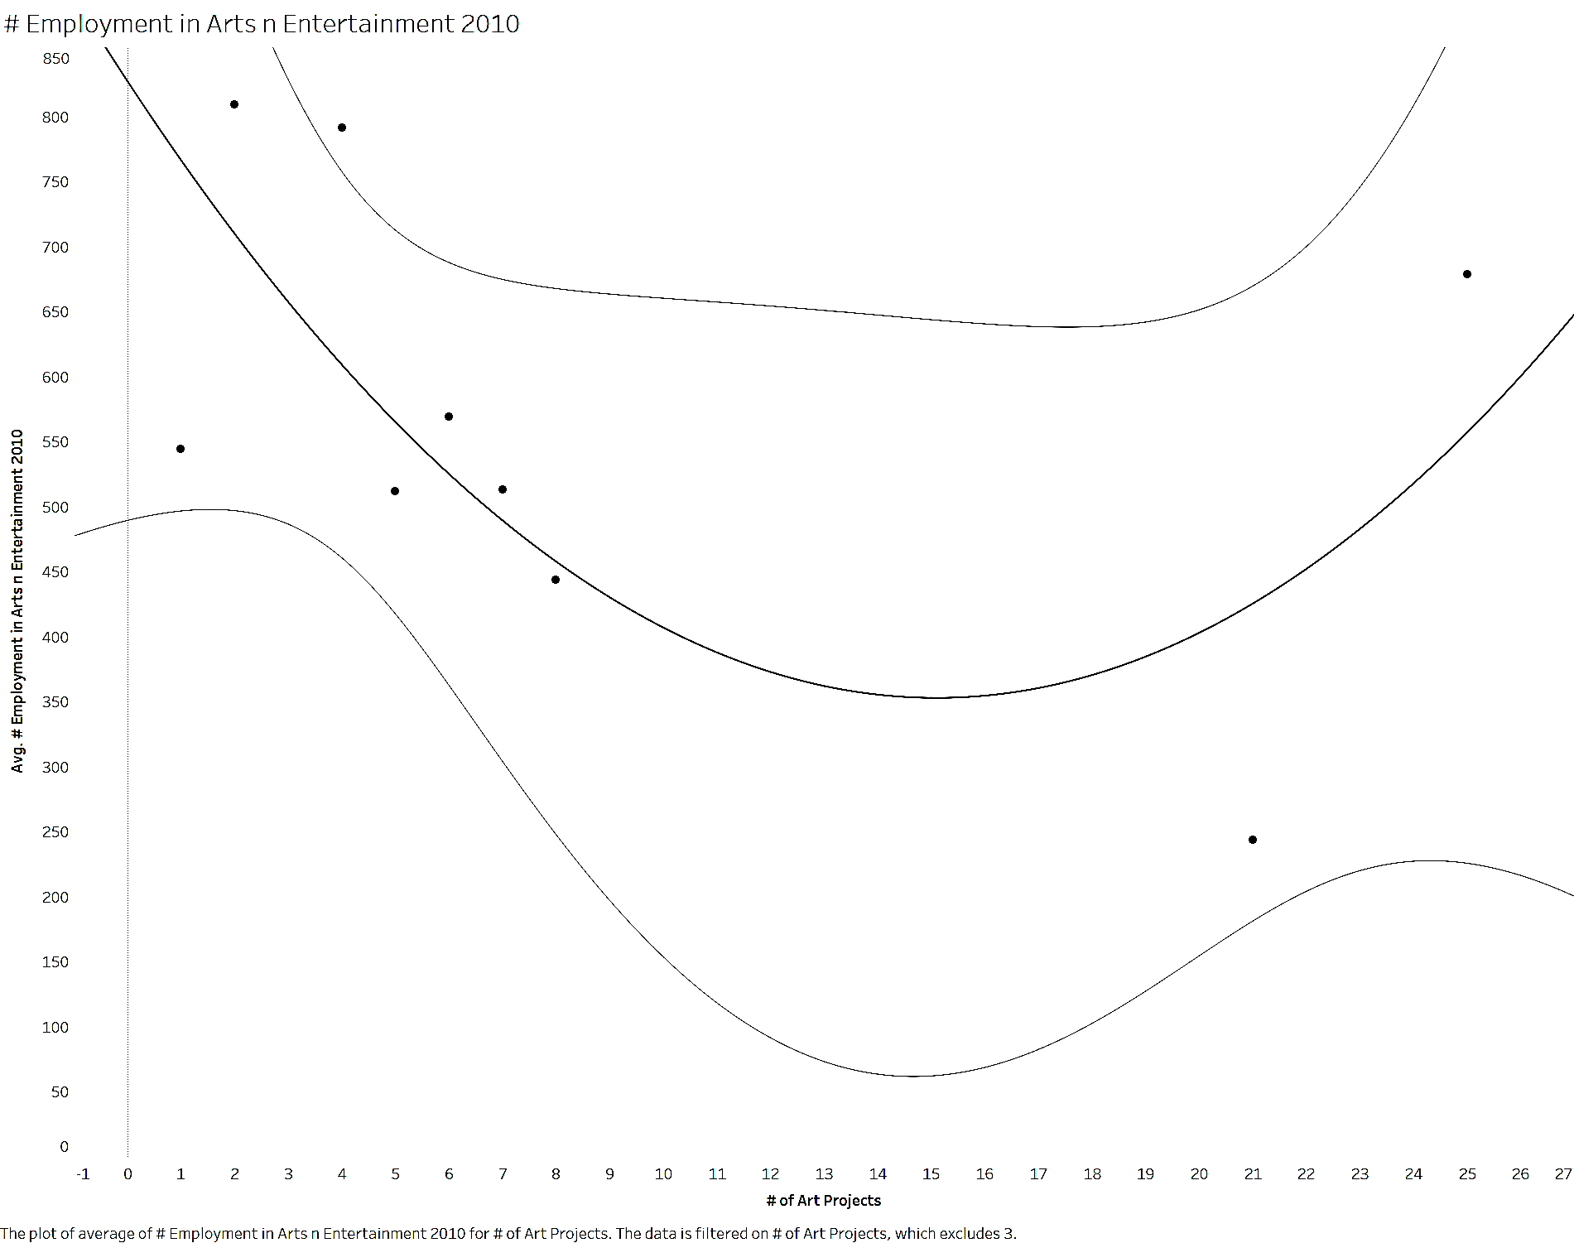
Analysis of 2010 Employment in Arts and Entertainment
Trend Lines Model
A polynomial trend model of degree 2 is computed for average of # Employment in Arts n Entertainment 2010 given # of Art Projects.
Model formula: | ( # of Art Projects^2 + # of Art Projects + intercept )
Number of modeled observations: | 9
Number of filtered observations: | 1
Model degrees of freedom: | 3
Residual degrees of freedom (DF): | 6
SSE (sum squared error): | 145654
MSE (mean squared error): | 24275.6
R-Squared: | 0.411736
Standard error: | 155.806
p-value (significance): | 0.203572
Panes |  | Line |  | Coefficients
Row | Column | p-value | DF | Term | Value | StdErr | t-value | p-value
# Employment in Arts n Entertainment 2010 | # of Art Projects | 0.203572 | 6 | # of Art Projects^2 | 2.08037 | 1.22757 | 1.6947 | 0.141068
 |  |  |  | # of Art Projects | -62.8336 | 33.2791 | -1.88808 | 0.107939
 |  |  |  | intercept | 827.398 | 138.151 | 5.98908 | 0.0009738

Slide 29
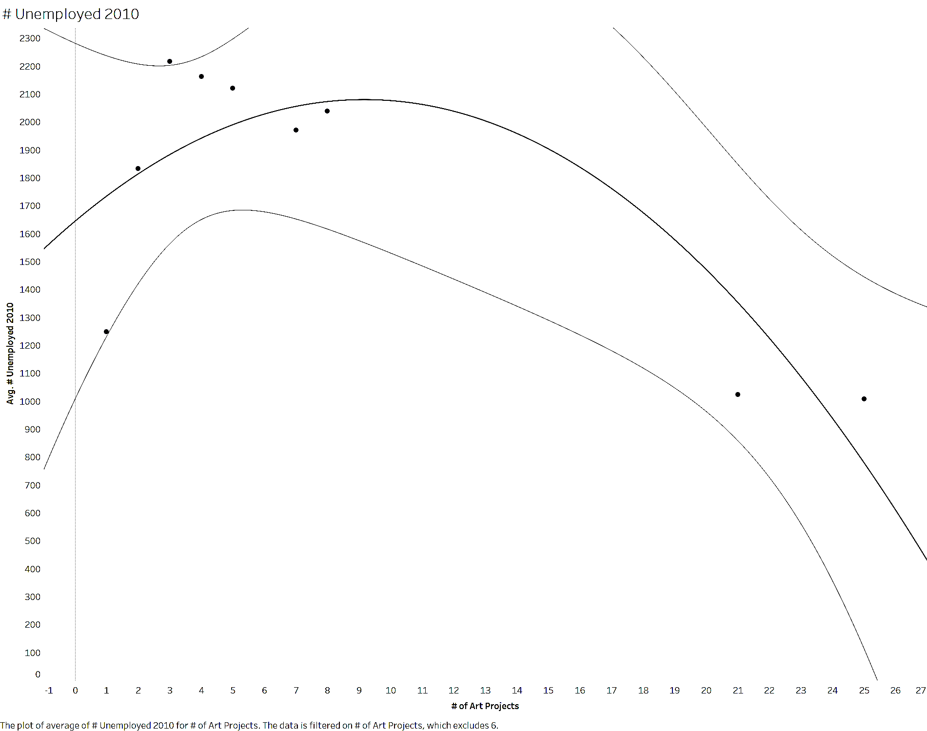
Analysis of 2010 # Unemployed
Trend Lines Model
A polynomial trend model of degree 2 is computed for average of # Unemployed 2010 given # of Art Projects. The model may be significant at p <= 0.05.
Model formula: | ( # of Art Projects^2 + # of Art Projects + intercept )
Number of modeled observations: | 9
Number of filtered observations: | 1
Model degrees of freedom: | 3
Residual degrees of freedom (DF): | 6
SSE (sum squared error): | 583840
MSE (mean squared error): | 97306.7
R-Squared: | 0.707024
Standard error: | 311.94
p-value (significance): | 0.0251475
Panes |  | Line |  | Coefficients
Row | Column | p-value | DF | Term | Value | StdErr | t-value | p-value
# Unemployed 2010 | # of Art Projects | 0.0251475 | 6 | # of Art Projects^2 | -5.18487 | 2.51997 | -2.05752 | 0.0853492
 |  |  |  | # of Art Projects | 95.0698 | 67.3784 | 1.41098 | 0.207937
 |  |  |  | intercept | 1643.96 | 260.626 | 6.30774 | 0.0007407

Slide 30
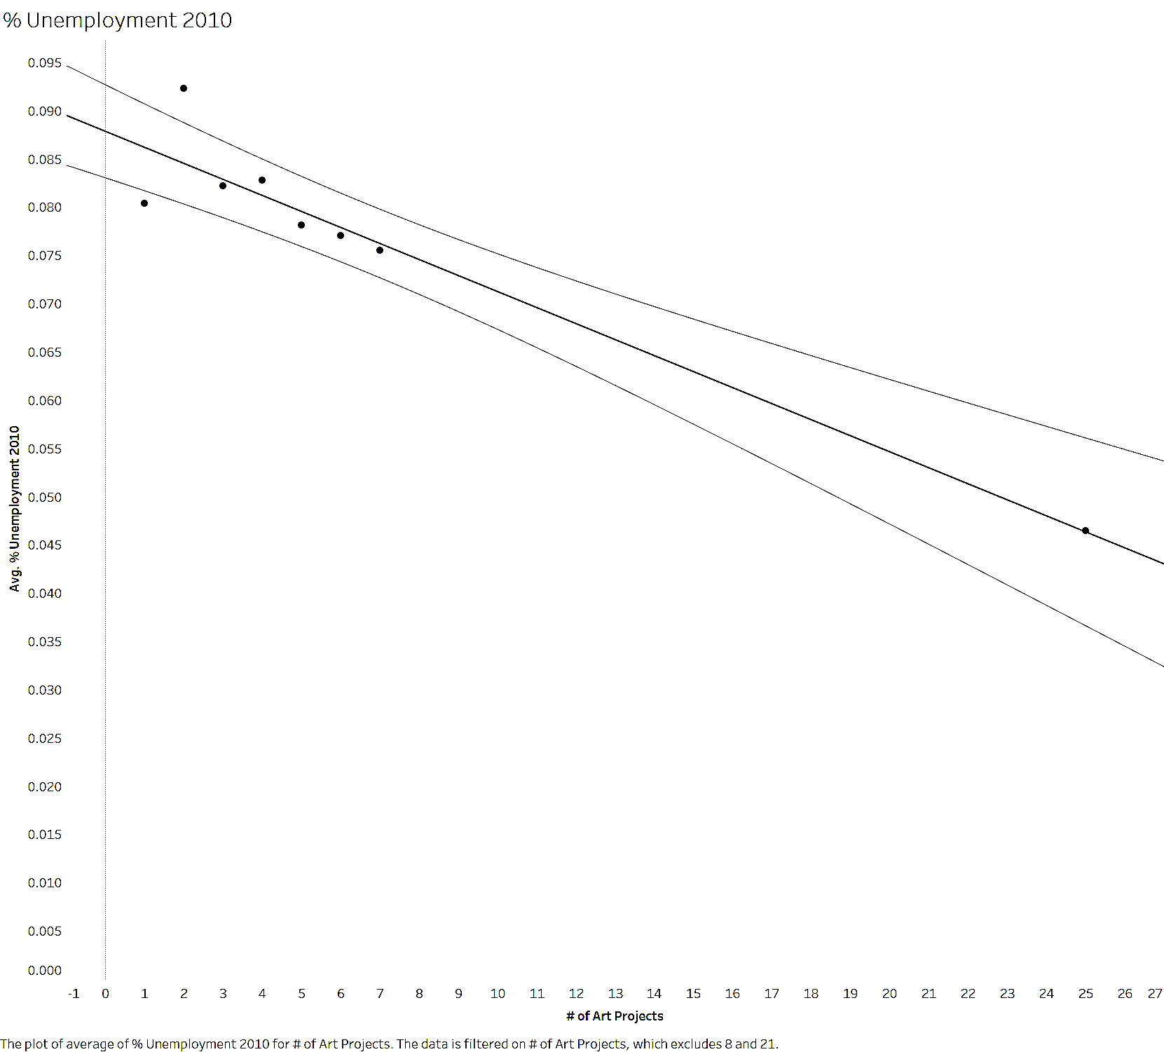
Analysis of 2010 % Unemployment
Trend Lines Model
A linear trend model is computed for average of % Unemployment 2010 given # of Art Projects. The model may be significant at p <= 0.05.
Model formula: | ( # of Art Projects + intercept )
Number of modeled observations: | 8
Number of filtered observations: | 1
Model degrees of freedom: | 2
Residual degrees of freedom (DF): | 6
SSE (sum squared error): | 0.0001008
MSE (mean squared error): | 1.681e-05
R-Squared: | 0.918811
Standard error: | 0.0040995
p-value (significance): | 0.0001726
Panes |  | Line |  | Coefficients
Row | Column | p-value | DF | Term | Value | StdErr | t-value | p-value
% Unemployment 2010 | # of Art Projects | 0.0001726 | 6 | # of Art Projects | -0.0016605 | 0.0002015 | -8.24023 | 0.0001726
 |  |  |  | intercept | 0.0878601 | 0.0019705 | 44.5875 | < 0.0001

